Slide 1


80 Cereals Data Analysis with MySQL
Presented By Adepegba David .a.

Slide 2

Table of contents
Problem Statement Dataset Details Data Transformation Insights Questions Insights Analysis Conclusion
Adepegba David .A.
CognoRise InfoTech
Internship Task

Slide 3

Problem Statement
Diabetes patients need to monitor their sugar intake to manage their condition effectively. With numerous cereal options available in the market, it becomes challenging to identify which ones are suitable for diabetes patients. This project aims to analyze the sugar content in various cereals and identify the best options for diabetes patients.
Adepegba David .A.
CognoRise InfoTech
Internship Task

Slide 4
Dataset Details
Name: Name of cereal
mfr: Manufacturer of cereal
type: Serving Type either Hot or Cold
calories: calories per serving
protein: grams of protein
fat: grams of fat
sodium: milligrams of sodium
fiber: grams of dietary fiber
carbo: grams of complex carbohydrates
sugars: grams of sugars
potass: milligrams of potassium
vitamins: vitamins and minerals - 0, 25, or 100, indicating the typical percentage of FDA recommended
shelf: display shelf (1, 2, or 3, counting from the floor)
weight: weight in ounces of one serving
cups: number of cups in one serving
rating: a rating of the cereals (Possibly from Consumer Reports?)
Adepegba David .A.
CognoRise InfoTech
Internship Task

Slide 5
Data Transformation: Cereals Characteristics
mfr: Manufacturer of cereal
A = American Home Food Products
G = General Mills
K = Kelloggs
N = Nabisco
P = Post
Q = Quaker Oats
R = Ralston Purina
type: Cold or Hot.
vitamins: vitamins and minerals - 0%, 25%, or 100%.
shelf: display shelf 1st Floor, 2nd Floor, or 3rd Floor
Unit of measurement:
grams: protein to protein_g, fat to fat_g, fiber to fiber_g, carbo to carbo_g, sugars to sugars_g.
milligram: sodium to sodium_mg, potass to potass_mg
ounce: weight to weight_oz
cups: cups to cup_c
Adepegba David .A.
CognoRise InfoTech
Internship Task

Slide 6
Data Transformation: MySQL Syntax
Adding the units of measurement
ALTER TABLE cereal
RENAME COLUMN protein TO protein_g,
RENAME COLUMN fat TO fat_g,
RENAME COLUMN sodium TO sodium_mg,
RENAME COLUMN fiber TO fiber_g,
RENAME COLUMN carbo TO carbo_g,
RENAME COLUMN sugars TO sugars_g,
RENAME COLUMN cups TO cups_c;
RENAME COLUMN potass TO potass_mg,
RENAME COLUMN weight TO weight_oz,
Adepegba David .A.
CognoRise InfoTech
Internship Task

Slide 7
Data Transformation: MySQL Syntax
NEED TO OFF THE SAFE UPDATE MODE IN SQL EDITOR
Adding percentage sign to the Vitamins.
Changing the datatype first.
ALTER TABLE cereal
CHANGE COLUMN vitamins vitamins TEXT;
UPDATE cereal
SET vitamins = ‘0%’
WHERE vitamins = 0;
UPDATE cereal
SET vitamins = '25%’
WHERE vitamins = 25;
UPDATE cereal
SET vitamins = '100%’
WHERE vitamins = 100;
Adepegba David .A.
CognoRise InfoTech
Internship Task

Slide 8
Data Transformation: MySQL Syntax
NEED TO OFF THE SAFE UPDATE MODE IN SQL EDITOR
Giving the full name of the manufacturer
UPDATE cereal
SET mfr = 'American Home Food Products’
WHERE mfr = 'A’;
UPDATE cereal
SET mfr = 'General Mills’
WHERE mfr = 'G’
;UPDATE cereal
SET mfr = 'Kelloggs’
WHERE mfr = 'K’;
UPDATE cereal
SET mfr = 'Nabisco’
WHERE mfr = 'N’;
UPDATE cereal
SET mfr = 'Post’
WHERE mfr = 'P’;
UPDATE cereal
SET mfr = 'Quaker Oats’
WHERE mfr = 'Q’;
UPDATE cereal
SET mfr = 'Ralston Purina’
WHERE mfr = 'R’;
Adepegba David .A.
CognoRise InfoTech
Internship Task

Slide 9
Data Transformation: MySQL Syntax
NEED TO OFF THE SAFE UPDATE MODE IN SQL EDITOR
Renaming the type
UPDATE cereal
SET type = 'Cold’
WHERE type = 'C’;
UPDATE cereal
SET type = 'Hot’
WHERE type = 'H’;
Renaming the shelf
First Change the data type to Text
ALTER TABLE cereal
CHANGE COLUMN shelf shelf TEXT NOT NULL;
UPDATE cereal
SET shelf = '1st Floor’
WHERE shelf = '1’;
UPDATE cereal
SET shelf = '2nd Floor’
WHERE shelf = 2;
UPDATE cereal
SET shelf = '3rd Floor’
WHERE shelf = 3;
Adepegba David .A.
CognoRise InfoTech
Internship Task

Slide 10
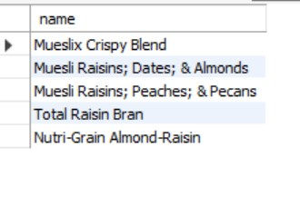
Insights Questions
What are the top 5 cereals with the highest calorie count?
SELECT name
FROM cereal
ORDER BY calories DESC
LIMIT 5;
Adepegba David .A.
CognoRise InfoTech
Internship Task

Slide 11
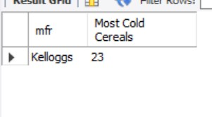
Insights Questions
Which manufacturer has the most cold cereals?
SELECT mfr, COUNT(name) 'Most Cold Cereals’
FROM cereal
WHERE type = 'cold’
GROUP BY mfr
Adepegba David .A.
CognoRise InfoTech
Internship Task

Slide 12
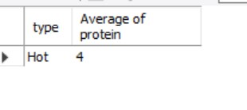
Insights Questions
What is the average protein content of hot cereals?
SELECT type, AVG(protein_g) 'Average of protein’
FROM cereal
WHERE type = 'hot’
GROUP BY type;
Adepegba David .A.
CognoRise InfoTech
Internship Task

Slide 13
Insights Questions
List all cereals with less than 10g of fat per serving.
SELECT name
FROM cereal
WHERE fat_g < 10;
All of the cereals in the dataset contain less than 10 grams of fat.
Adepegba David .A.
CognoRise InfoTech
Internship Task

Slide 14
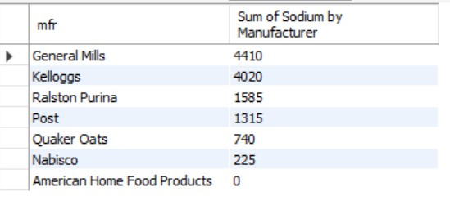
Insights Questions
What is the total sodium content of all cereals from a specific manufacturer?
SELECT mfr, SUM(sodium_mg) 'Sum of Sodium by Manufacturer’
FROM cereal
GROUP BY mfr
ORDER BY SUM(sodium_mg) DESC;
Adepegba David .A.
CognoRise InfoTech
Internship Task

Slide 15
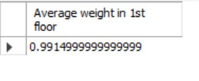
Insights Questions
What is the average weight (in ounces) of all cereals on shelf display 1st Floor?
SELECT AVG(weight_oz) 'Average weight in 1st floor’
FROM cereal
WHERE shelf ='1st floor';
Adepegba David .A.
CognoRise InfoTech
Internship Task

Slide 16

Insights Questions
List all cereals with a rating above 80%.
SELECT name, rating
FROM cereal
WHERE rating > 80;
Adepegba David .A.
CognoRise InfoTech
Internship Task

Slide 17
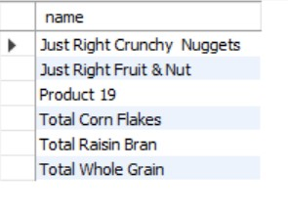
Insights Questions
Which cereal has the highest vitamin content (100% of the daily value)?
SELECT name
FROM cereal
WHERE vitamins = '100%';
Adepegba David .A.
CognoRise InfoTech
Internship Task

Slide 18
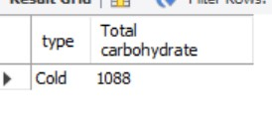
Insights Questions
What is the total carbohydrate content of all cold cereals?
SELECT type, SUM(carbo_g) 'Total carbohydrate’
FROM cereal
GROUP BY type
HAVING type = 'cold';
Adepegba David .A.
CognoRise InfoTech
Internship Task

Slide 19
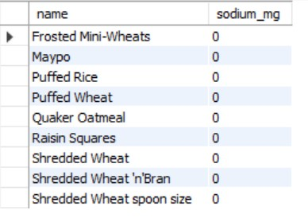
Insights Questions
Find the cereal with the lowest sodium content per serving.
SELECT name, sodium_mg
FROM cereal
WHERE sodium_mg = (SELECT MIN(sodium_mg) FROM cereal);
Adepegba David .A.
CognoRise InfoTech
Internship Task

Slide 20
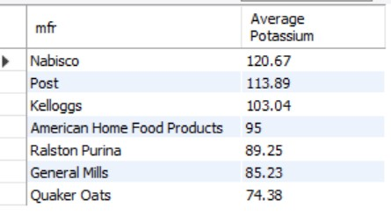
Insights Questions
What is the average potassium content of all cereals from a specific manufacturer?
SELECT mfr, ROUND(AVG(potass_mg),2) 'Average Potassium’
FROM cereal
GROUP BY mfr
ORDER BY 2 DESC;
Adepegba David .A.
CognoRise InfoTech
Internship Task

Slide 21
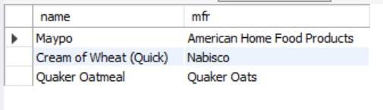
Insights Questions
List all cereals with a specific type (hot or cold) and the manufacturer.
SELECT name,mfr
FROM cereal
WHERE type = 'hot’
ORDER BY mfr;
Adepegba David .A.
CognoRise InfoTech
Internship Task

Slide 22
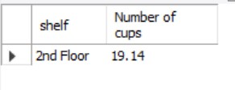
Insights Questions
What is the total number of cups per serving for all cereals on shelf display 2nd floor?
SELECT shelf, SUM(cups_c) 'Number of cups’
FROM cereal
GROUP BY shelf
HAVING shelf = '2nd floor';
Adepegba David .A.
CognoRise InfoTech
Internship Task

Slide 23
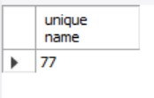
Insights Questions
How many unique name are in the dataset
SELECT COUNT(DISTINCT name) 'unique name’
FROM cereal;
Adepegba David .A.
CognoRise InfoTech
Internship Task

Slide 24

Insights Questions
Which product have the lowest rating and what the sugar volume
SELECT name, rating, sugars_g
FROM cereal
WHERE rating = (SELECT MIN(rating) FROM cereal);
Adepegba David .A.
CognoRise InfoTech
Internship Task

Slide 25
Insights Questions
Retrieve all the information about the highest food weight
SELECT *
FROM cereal
WHERE weight_oz = (SELECT MAX(weight_oz) FROM cereal);
Adepegba David .A.
CognoRise InfoTech
Internship Task

Slide 26

Insights Questions
Which cereal have the high sugar and what is the rating
SELECT name, sugars_g, rating
FROM cereal
WHERE sugars_g = (SELECT MAX(sugars_g) FROM cereal);
Adepegba David .A.
CognoRise InfoTech
Internship Task

Slide 27
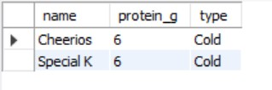
Insights Questions
Find the cereal with the highest protein content per serving to help manage blood sugar levels and the serving type
SELECT name, protein_g, type
FROM cereal
WHERE protein_g = (SELECT MAX(protein_g) FROM cereal) AND type = 'cold';
Adepegba David .A.
CognoRise InfoTech
Internship Task

Slide 28
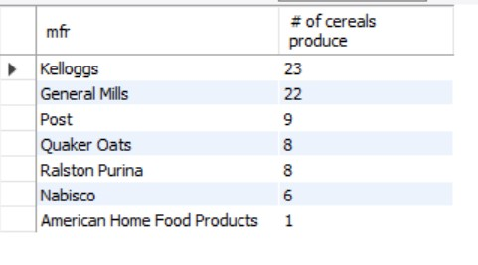
Insights Questions
How many cereal did each mfr produce order by the type
SELECT mfr, COUNT(*) '# of cereals produce’
FROM cereal
GROUP BY mfr
ORDER BY 2 DESC;
Adepegba David .A.
CognoRise InfoTech
Internship Task

Slide 29
Insights Questions
Which cereals have less than 30g of carbohydrates per serving?
SELECT name, carbo_g
FROM cereal
WHERE carbo_g < 30;
All of the cereals in the dataset contain less than 30 grams of carbohydrates.
Adepegba David .A.
CognoRise InfoTech
Internship Task

Slide 30
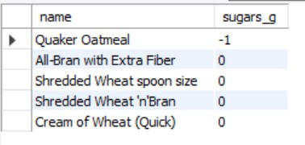
Insights Questions
What are the top 5 cereals with the lowest sugar content per serving?
SELECT name, sugars_g
FROM cereal
ORDER BY sugars_g
LIMIT 5;
Adepegba David .A.
CognoRise InfoTech
Internship Task

Slide 31
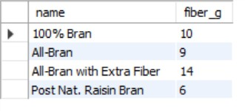
Insights Questions
Find all cereals with a high fiber content (more than 5g per serving) to help manage blood sugar levels.
SELECT name, fiber_g
FROM cereal
WHERE fiber_g > 5;
Adepegba David .A.
CognoRise InfoTech
Internship Task

Slide 32
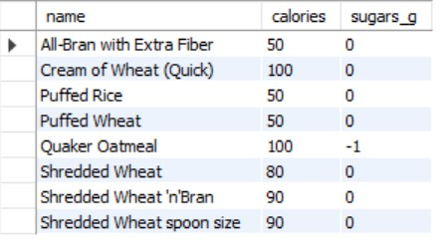
Insights Questions
Which cereals have a low calorie count (less than 150 per serving) and low sugar content?
SELECT name, calories, sugars_g
FROM cereal
WHERE calories < 150 AND sugars_g <=0;
Adepegba David .A.
CognoRise InfoTech
Internship Task

Slide 33

Insights Questions
What is the average carbohydrate content of all cold cereals?
SELECT type, AVG(carbo_g) 'Average of Carbohydrate Content’
FROM cereal
GROUP BY type
HAVING type = 'cold';
Adepegba David .A.
CognoRise InfoTech
Internship Task

Slide 34
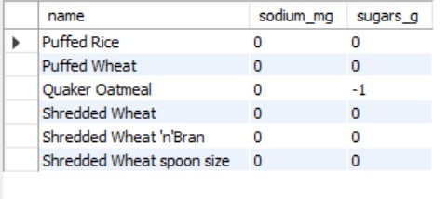
Insights Questions
List all cereals with a low sodium content (less than 50mg per serving) and low sugar content.
SELECT name, sodium_mg, sugars_g
FROM cereal
WHERE sodium_mg < 50 AND sugars_g <= 0;
Adepegba David .A.
CognoRise InfoTech
Internship Task

Slide 35
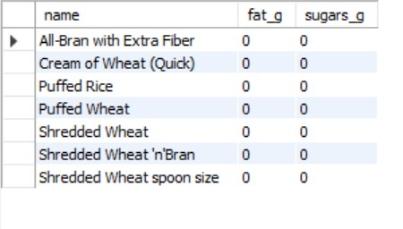
Insights Questions
Which cereals have a low fat content (less than 2g per serving) and low sugar content?
SELECT name, fat_g, sugars_g
FROM cereal
WHERE fat_g < 2 AND sugars_g <= 0;
Adepegba David .A.
CognoRise InfoTech
Internship Task

Slide 36

Insights Questions
Which cereals have a high fiber content and low sugar content per serving?
SELECT name, sugars_g, fiber_g
FROM cereal
WHERE sugars_g <= 0 AND fiber_g = (SELECT MAX(fiber_g) FROM cereal);
Adepegba David .A.
CognoRise InfoTech
Internship Task

Slide 37

Insights Questions
List all cereals with a rating above 80% and low sugar content per serving.
SELECT name, rating, sugars_g
FROM cereal
WHERE rating > 80 AND sugars_g <= 0;
Adepegba David .A.
CognoRise InfoTech
Internship Task

Slide 38
Insights Analysis
Kellogg's produces the most cold cereals, with 23 cereals in the dataset.
The average protein content of hot cereals is 4.
1088 grams of carbohydrates are present in all cold cereals.
The dataset contains 77 distinct kinds of cereal.
Cap 'n' Crunch, which has a rating of 18.04% and 12 grams of sugar, is the cereal with the lowest rating.
Adepegba David .A.
CognoRise InfoTech
Internship Task

Slide 39
Insights Analysis
The highest sugar content per gram is 15, with Golden Crisp rated 35.25 and Smacks rated 31.23.
To help manage blood sugar levels, Cheerios and Special K have the highest protein and can be served cold.
With only -1 grams of sugar and 100 calories, Quaker Oatmeal has the lowest sugar content.
100% Bran and All-Bran with extra fiber have high fiber contents of 14 and 10 grams, respectively, to help control blood sugar levels.
Cold cereals typically contain 14.7 grams of carbs on average.
Adepegba David .A.
CognoRise InfoTech
Internship Task

Slide 40
Conclusion
The analysis has identified several cereal options that are suitable for diabetes patients aiming to manage their blood sugar levels and nutrient intake. The top recommendations are:
All Bran with Extra Fiber and 100% Bran, which offer high fiber content to support digestive health and satiety.
Cheerios and Special K, which provide high protein content to help regulate blood sugar and insulin levels.
Quaker Oatmeal, which offers a low sugar and calorie content, making it an excellent choice for diabetes patients.
These cereals can be incorporated into a balanced diet, taking into account individual calorie and nutrient needs. Diabetes patients should aim to consume 25-30 grams of fiber, 15-20% of protein, and limit sugar intake to less than 10% of daily calories.
By choosing these cereals, diabetes patients can effectively manage their blood sugar levels, maintain a healthy weight, and reduce the risk of complications. It is essential to remember that a balanced diet should be combined with regular physical activity and medication adherence (if prescribed) to effectively manage diabetes.
Adepegba David .A.
CognoRise InfoTech
Internship Task

Slide 41


